Slide 1


$µ$-CON Workshop’18
“ Wireless Game Controller
Using Infrared Data Transmission ”

Slide 2
Session 2: Basics of Embedded C & Microcontrollers
29th Sep’18, 09:00 to 12:00 Hrs.

Slide 3
What is embedded C ?
C language is a software designed with different keywords, data types, variables, constants, etc.
Embedded C is a generic term given to a programming language written in C, which is associated with a particular hardware architecture.
Embedded C is an extension to the C language with some additional header files. These header files may change from controller to controller.
Also in embedded C , instead of logical operators , we use bitwise operators.
For microcontroller 8051 , #include<reg51.h> is used. Arduino uses the header file <avr/io.h>

Slide 4
Some Specific Data Types for Embedded programming
In embedded systems , there is a constraint of the memory available to the processor for executing tasks , so we use some special data types for this purposes:
uint8_t : the variable can contain only 8 bits
uint16_t : variable can contain only 16 bits
uint32_t : variable can contain only 32 bits
uint64_t : variable can contain only 64 bits
volatile : the value of the variable can change through out the program
Other than that , the normal data type of C – int , long , short , float , double , char retain their use in embedded C.

Slide 5
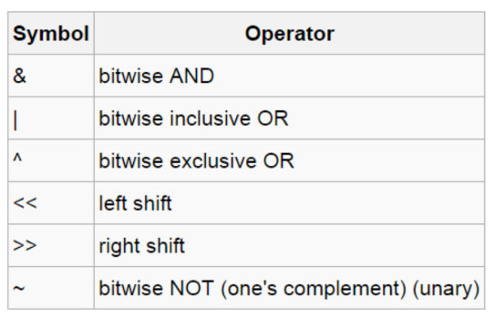
Bitwise Operators

Slide 6
Bitwise Operation
One of the main differences between C and Embedded C is that we deal with bit manipulation to a much greater extent in case of latter. That’s why understanding Bitwise operation become so much important.
AND rules : 0&0=0
1&0=0
1&1=1
e.g. 1001&0101=0001
OR operation : 0|0=0
1|0=1
1|1=1
e.g. 11110101 | 01001010 = 11111111
Exclusive OR : 1^0=1
1^1=0
0^0=0
e.g. 11010011 ^ 10010100=01000100
Note: Most important purpose if Exclusive OR is to toggle a bit while keeping other bits intact (bit masking).

Slide 7
Bitwise Operation (Contd..)
Left shift : In a n-bit number , left shifting by ‘ i ’ steps means to add 2^i-1 to the number.
1<<i= 2^i-1 e.g. 1<<4= 1000
Note: 1100 0100|=1<<4 is equal to 11001100
BUT
1100 0100 <<2 = 1100010000
<< 2 =
8-bit number converted to 10 bit
Right Shift : For a n-bit number . Right shifting by ‘n’ bits changes adds n
zeroes on the left and truncates n bit from the right.
e.g. 0010 1100 >>3 gives 0000 0101
0010 1 100 000 0 0101
0 | 0 | 1 | 1 | 0 | 0 | 0 | 1 | 0 | 0
1 | 1 | 0 | 0 | 0 | 1 | 0 | 0 | 0 | 0

Slide 8
Bitwise Operation (Contd..)
Important Points :
The left shift and right shift operators should not be used for negative numbers. The result is of undefined behaviour if any of the operands is a negative number. For example results of both -1 << 1 and 1 << -1 is undefined.
If the number is shifted more than the size of integer, the behaviour is undefined. For example, 1 << 33 is undefined if integers are stored using 32 bits. See this for more details.
The left-shift by 1 and right-shift by 1 are equivalent to multiplication and division by 2 respectively. As mentioned in point 1, it works only if numbers are positive.

Slide 9
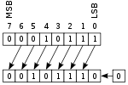
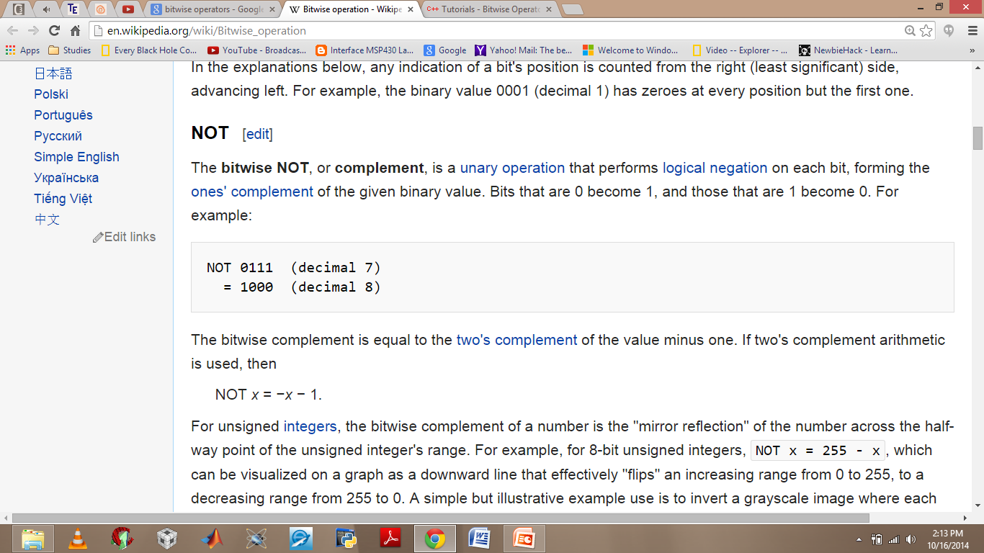
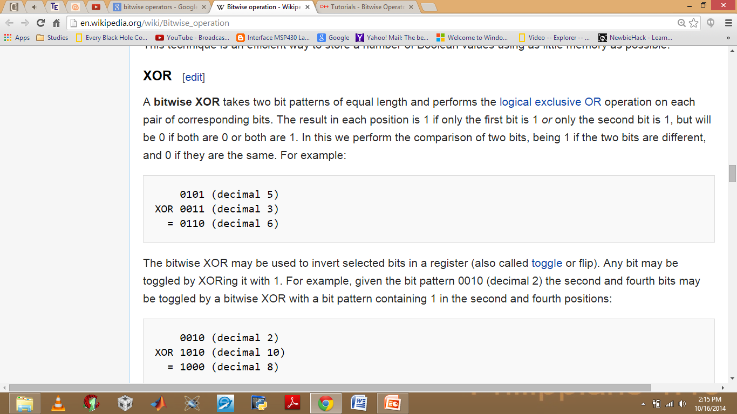
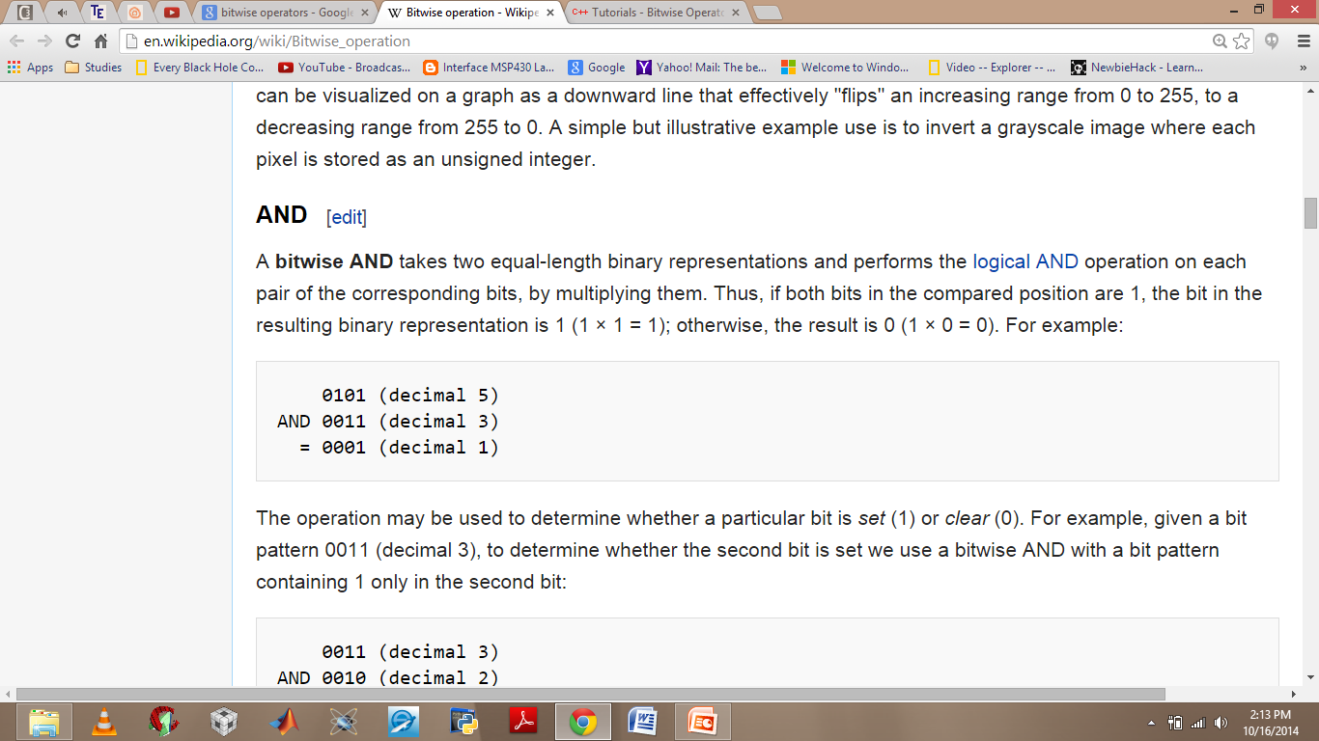
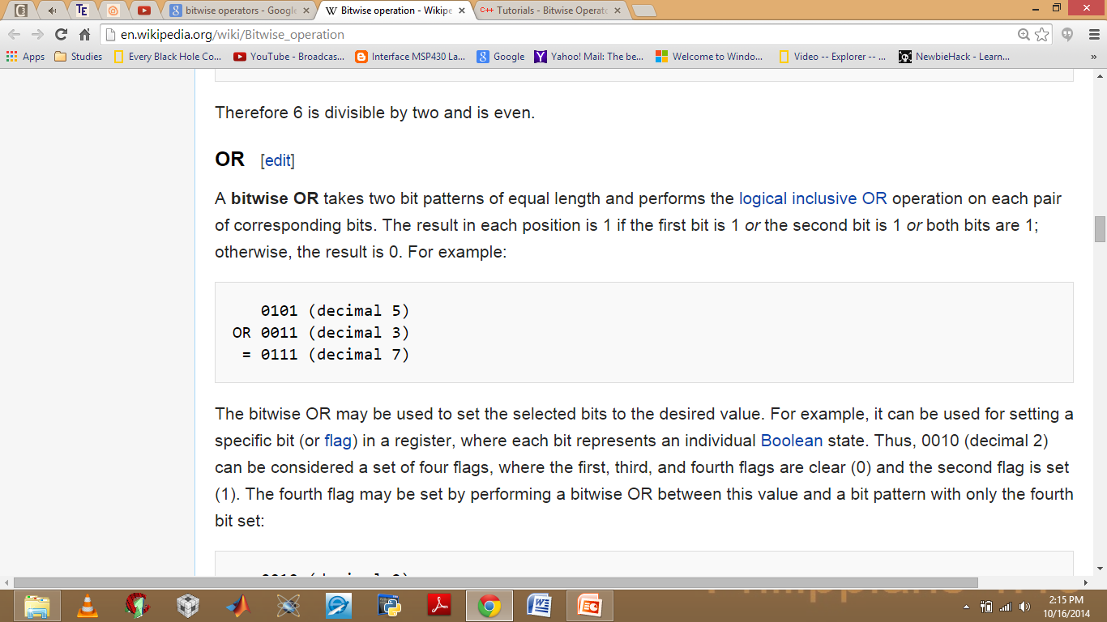
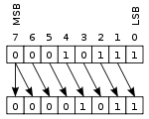
Bitwise Operation (Contd..)
Left Shifting
Right Shifting

Slide 10
Bitwise Operation (Contd..)
10101010 << 1 = ?
Ans:
10101010 | = (1<< 0) ?
Ans:
01010100
10101010 | 00000001 = 10101011
00000000 << 1 = ?
Ans:
11101110 & = (1<< 3) ?
Ans:
00000000
11101110 & 00001000 = 00001000
11101001 >> 2 = ?
Ans:
00111010
11100000 | = (1<< 3) | (1<< 4) | (1<<0) ?
Ans:
00010000 | 00001000 | 00000001 = 00011001
11100000 | 00011001 = 11111001
11101001 << -1 = ?
Ans:
undefined

Slide 11
Bit Masking
It is a technique by which we obtain only the required data and block(mask) the rest.
e.g. in 1101 0011 , our interest is in 6th bit. Say during course of program we want to know if 6th bit has changed to 1. Let uint8_t data=11010011. Then we’ll write
if( data&(1<<6))
This while check only the 6th bit value blocking the rest of the bits.
Bit masking is of particular interest in dealing with interrupt flags or certain end conditions.
e.g. in ADC conversion , we check if conversion is complete by
while(ADSCRA&(1<<ADIF)==0);
in Timers , we’ll see that we check timer overflow by while(TIFR&(1<<TOVn)==0);

Slide 12
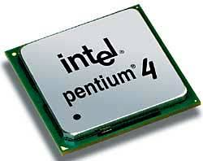
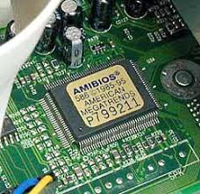
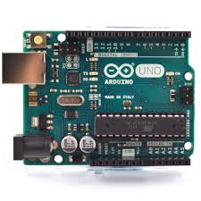
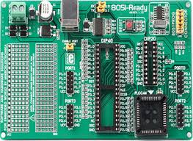
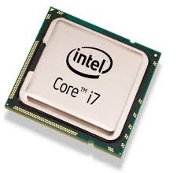
Difference between microprocessor and microcontroller
Microprocessors containonly the CPU part. All other elements like RAM , ROM , Clock etc have to be externally added by designing engineer. Also they operate at much higher speed (>1GhZ) and are aimed for a wide array of tasks. e.g Intel Pentium , i3, i5 etc
Microcontrollers on the other hand are designed for specific tasks , they have their own RAM , ROM , Clock embedded along with the microprocessor on a single chip. Also known as System on Chip (SOC); e.g. Atmel , Microchip , Raspberry Pi , Beaglebone , Intel 8051 etc.

Slide 13
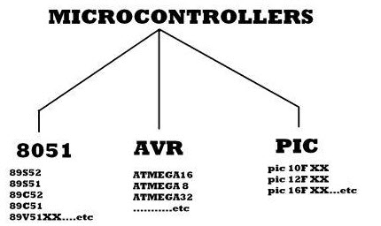
Introduction to MicroControllers
A microcontroller is a small, low-cost and self contained computer-on-a-chip that can be used as an embedded system. A few microcontrollers may utilize four-bit expressions and work at clock rate frequencies, which usually include:
An 8 or 16 bit microprocessor.
A little measure of RAM.
Programmable ROM and flash memory.
Parallel and serial I/O.
Timers and signal generators.
Analog to Digital and Digital to Analog conversion.
Microcontrollers usually must have low-power requirements since many devices they control are battery-operated. Microcontrollers are used in many consumer electronics, car engines, computer peripherals and test or measurement equipment. And these are well suited for long lasting battery applications.
We’ll focus our discussion on AVR Microcontrollers as we’ll be dealing with them throughout the course of workshop.

Slide 14
AVR Microcontrollers
AVR microcontroller is developed by Alf-Egil Bogen and Vegard Wollan from Atmel Corporation. The AVR microcontrollers are modified harvard RISC architecture with separate memories for data and program and speed of AVR is high when compare to 8051 and PIC. The AVR is stands for Alf-Egil Bogen and Vegard Wollan’s RISC processor.
Difference between 8051 and AVR Controllers:
8051s are 8-bit controllers based on CISC architecture, AVRs are 8-bit controllers based on RISC architecture
8051 consumes more power than AVR microcontroller.
In 8051, we can program easily than the AVR microcontroller.
The speed of AVR is more than the 8051 microcontroller.
There are many AVR family microcontrollers, such as ATmega8, ATmega16 , ATMEGA328 and so on. The ATmega328 has flash memory of 32kB, where the ATmega8 has 8kB and ATmega16 has 16kB.

Slide 15
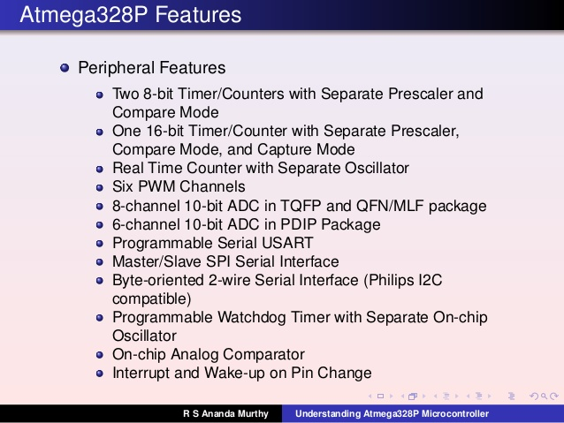
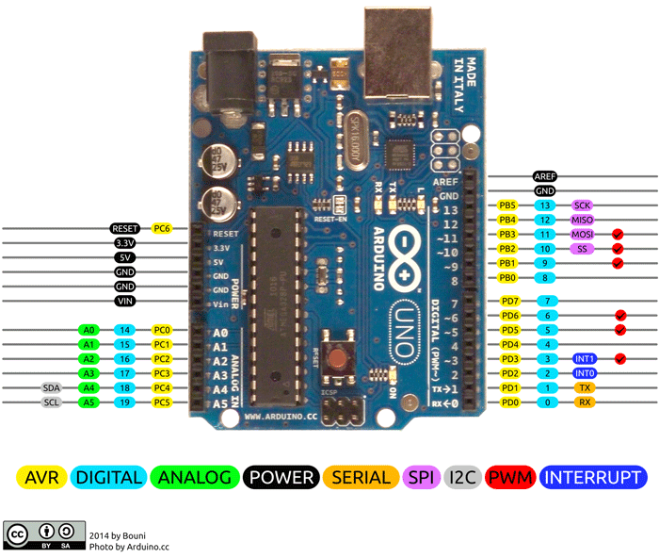
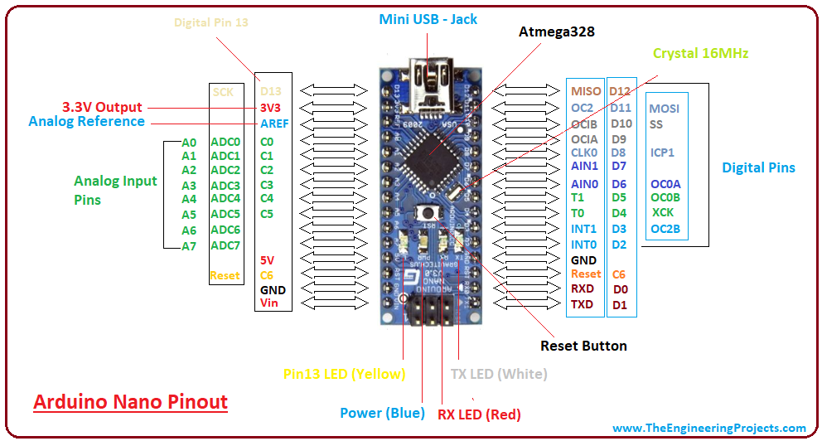
ATmega328

Slide 16
Difference between Arduino Nano & UNO
Name of part | Arduino Nano | Arduino Uno
Microkontroller | ATmega328 | ATmega328P
Operating Voltage | 5V | 5V
Input Voltage (recommended) | 7 – 12V | 7 – 12V
Digital I/O Pins | 20 | 20
PWM Digital I/O Pins | 6 | 6
Analog Input Pins | 8 | 6
DC Current per I/O Pin | 40 mA | 20 mA
Clock Speed | 16 MHz | 16 MHz
Flash Memory | 32 KB of which 2 KB used by bootloader | 32 KB (ATmega328P) of which 0.5 KB used by bootloader
SRAM | 2 KB | 2 KB
EEPROM | 1 KB | 1 KB
LED_BUILTIN | 13 | 13
USB-to-serial converter | FTDI 232 | Atmega16U2 (Atmega8U2 up to version R2)
Both use ATmega328 as microprocessor but they differ in their packaging.
Nano is based on TPQF(Thin Plastic Quad Flat Package) while UNO is based on PDIP(Plastic In-line Packages). Therefore they differ in total number of pins – NANO has 32 while UNO has 28. So NANO has 2 extra Analog I/0 pins , hence two extra ADC channels ,ADC6 & ADC7 compared to ADC0-ADC5 of UNO. But the ADC6 & ADC7 in NANO cannot be used as Digital I/O pins.

Slide 17

Why Arduino?
Cheap
Easy to learn and use and above all
Current consumption is in micro-amperes!
The perfect solution for an embedded system

Slide 18
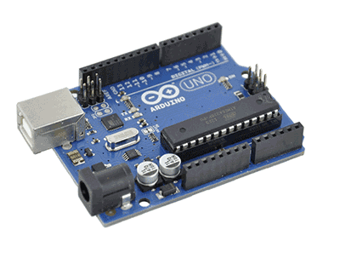
What does Arduino Uno offers ?
14 General Purpose I/O
6 channel 10bit ADC
512 Bytes RAM (temporary memory)
16 Kb Flash (permanent memory)
Communication Protocols
UART
I2C
SPI
Two 16-bit timers
PWM

Slide 19

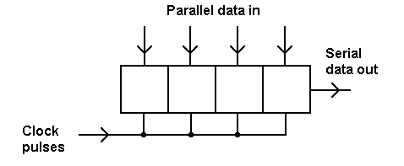
Interacting with Micro Controller
Microcontroller is a piece of Hardware. We need a way to interact with it. So how do we do it ? We take help of registers. They are named memory locations associated with each piece of hardware element. By writing/reading values to/from it , we can code the MCU and get our tasks done.

Slide 20
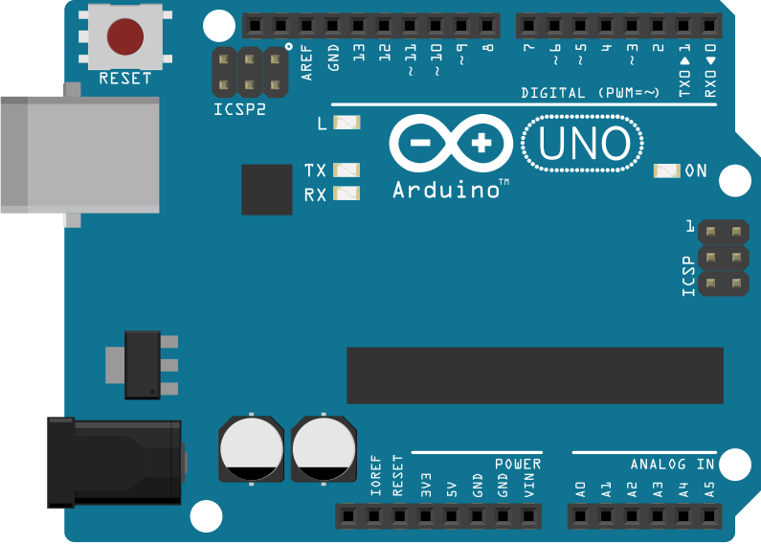
PORTS:
AVR is a 8 bit microcontroller, so all of its ports are 8 bit wide.
Every port has 3 registers associated with it, each register being 8 bits long.
The three registers are as follows :
(x can be replaced by A,B,C,D as per the AVR you are using)
DDRx register : Sets the function of I/O port as input
or output.
- PORTx register : Writing 1 to it enables the pull up.
- PINx register : This is read only. We cannot write to it.

Slide 21
PORTS(Contd..):
Every bit in these registers configures the “status” of the corresponding pin, in a
particular port.
For example, Bit0 of register DDRA is associated with Pin0 of the port A, Bit1
of register PINC is associated with Pin1 of the port C and likewise.
PORT B
PORT A
PORT C
PORT D

Slide 22
DDRx Register
DDRx (Data Direction Register) configures the “data direction” of port pins.
That means, it determines whether the port pins will be used for input or
output operations.
Writing 0 to a bit in DDRx makes the corresponding port pin as input,
while writing 1 to a bit in DDRx makes corresponding port pin as output.
For example:
1) To make all pins of port A as input pins :
DDRA = 0b00000000;
2) To make all pins of port C as output pins :
DDRC = 0b11111111;
3) To make pin 5 and pin 7 as output, and the rest as input :
DDRB = 0b10100000

Slide 23
PORTx Register
When you set bits in DDRx to 1, the corresponding pins become “output” pins.
Now you can write data into respective bits in PORTx register. This will immediately
change the state of output pins according to the data you have written.
A digital 0, corresponds to zero voltage as output, while 1 corresponds to Vcc(3.3V/5V)
as the output voltage.
To output data on the port pins, you have to write to the PORTx register.
The data direction of the pin must be set as output first.
For example :
To output 0xFF data on port b
DDRB = 0b11111111; //set all pins of port b as outputs
PORTB = 0xFF; //write data on port

Slide 24
PINx Register
PINx (“Port IN”) is used to read data from port pins.
In order to read the data from a port pin, the pin's data direction must first be set to input.
This is done by setting the corresponding bit in DDRx to zero.
If port is made output, then reading the PINx register will give you the digital levels corresponding to the output voltage on the pins. There are two input modes, designated by digital level 0 or 1.
Zero corresponds to zero voltage on the pin, while 1 corresponds to V_{cc}( 3.3V/5V).
For example :
To read data from port A:
DDRB = 0x00; //Set the entire Port B as input
X = PINB; //Read contents of entire Port B

Slide 25
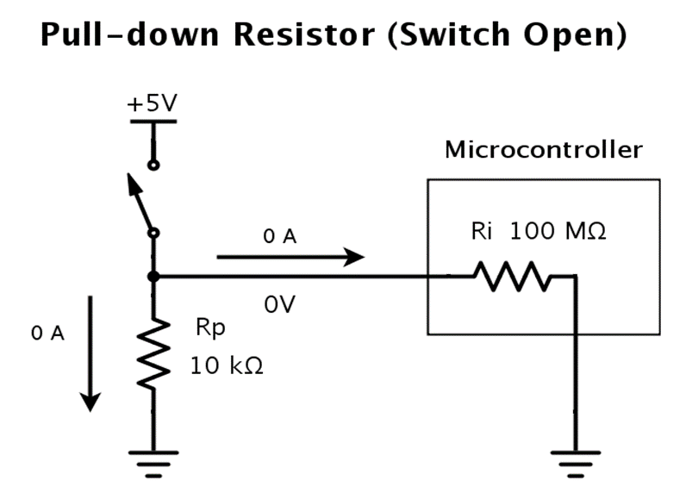
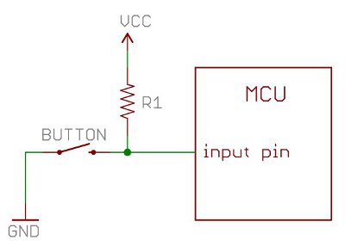
Pull Up & Pull Down
Pull Up : Making the Voltage at the corresponding pin High when no input is given.
Pull down : Making voltage at input pin 0V. By default , all pins in Arduino are pulled down only.
Default Case
DDRB = 0b00000000;//set input pins
PORTB = 0b11111111;//pull up

Slide 26
Example Code :
Glow LED using the concept of PORTx and PINx registers
#include<avr/io.h>
int main()
{
DDRD=0b1000000;
PORTD |=1<<PORTD7;
_delay_ms(100);
PORTD ^=1<<PORTD7;
}

Slide 27
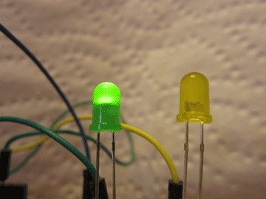
TASK 1
LETS BLINK THE LED

Slide 28
#include<avr/io.h>
#include<util/delay.h>
int main()
{
DDRB=(1<<5);
PORTB=(1<<5);
while(1) {
PROTB^=0xFF;
_delay_ms(2000);
}
return 0;
}
Looks Pretty ?
Wanna a make disco lights ?

Slide 29
TASK 2
Try making array of 5 LEDs and then make them blink in any order of your choice, just like disco lights.
#Hint1- individual led to individual port pin.
Then toggle (say blink) them in a pattern you like. And make a disco light, right there in your room.
#Hint 2– different time delay to different led for toggling can give you patterns

Slide 30
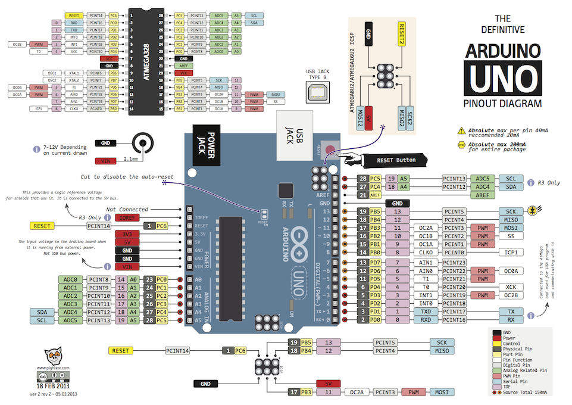

Slide 31
Thank You

